Slide 1
PROJECT PRESENTATION FOR “SALMANS”
Team members:
Chinedu Urbanus Ugwu - 610119
John Imhonikhe Lawal - 610098
Mohammed Seud - 109362
IN PARTIAL FULFILMENT OF THE REQUIREMENTS FOR PASSING CS425 – SOFTWARE ENGINEERING, MAHARISHI UNIVERSITY OF MANAGEMENT.
AUGUST, 2019

Slide 2
What is salmans?
A business management/appointment scheduling system
Helps customers of a salon make reservations, keeps track of their priorities and enables them to make reviews on the service they received.
Helps the administrator register new hairstylists and assign seat numbers to them.
Assigns hairstylists to customers who have made reservations.
Helps the administrator view summarized business performance information.

Slide 3
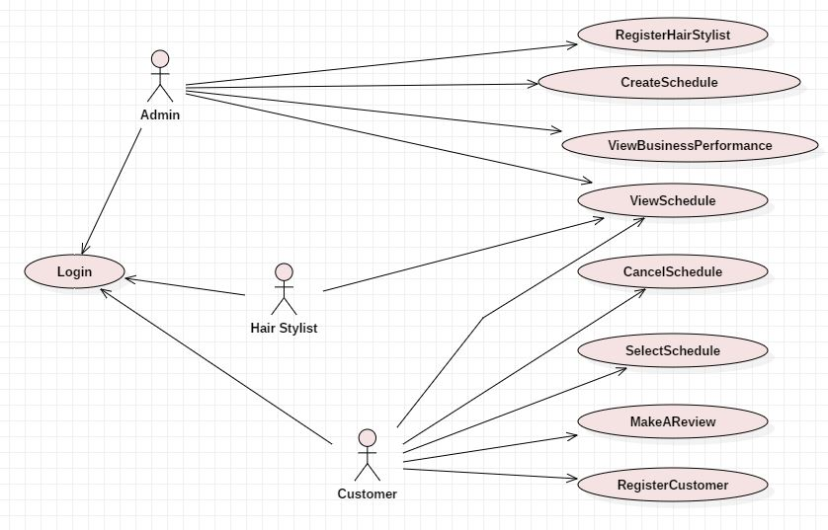
What are the use cases?

Slide 4
How will it be built?
Web Application
Accessible via web browsers
Enterprise Architecture
Will support multiple users at the same time
Client-Server Architecture
Which holds for all web applications. The client browsers make requests and the server send responses.
ORM for persistence
A simple way to map Entities to our Database
Provides amazing strategies to optimize our design for improved performance of our database operations.

Slide 5
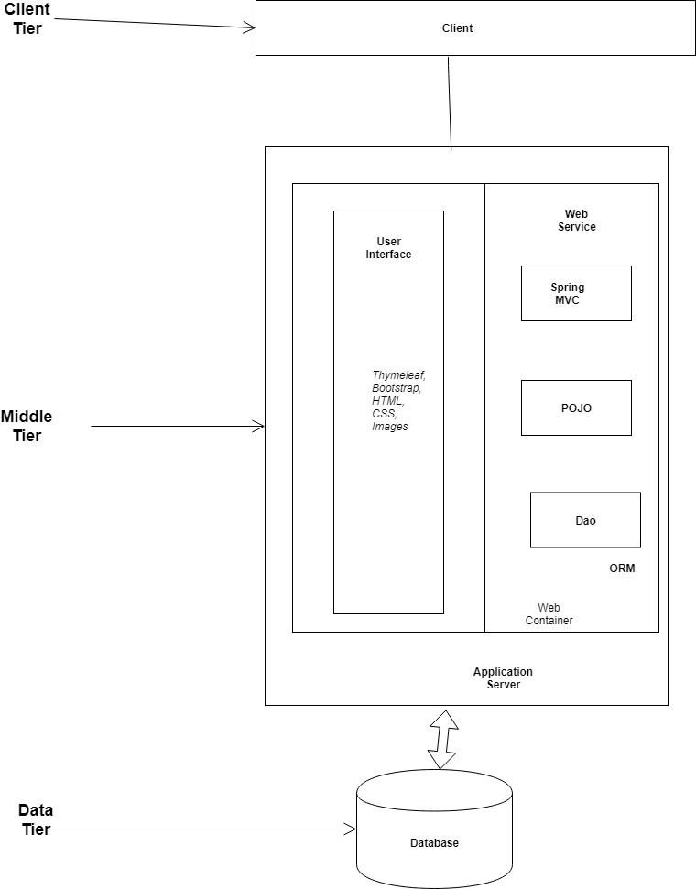
System architecture

